Slide 1
Principled Basics.

Slide 2
What is it.
Basic outfits
Catered towards those trying to get into fashion
Based on my own wardrobe and what I learned on reddit and through experimentation
Provides users with links to articles of clothing discussed ranging from a budget option to an enthusiast option

Slide 3
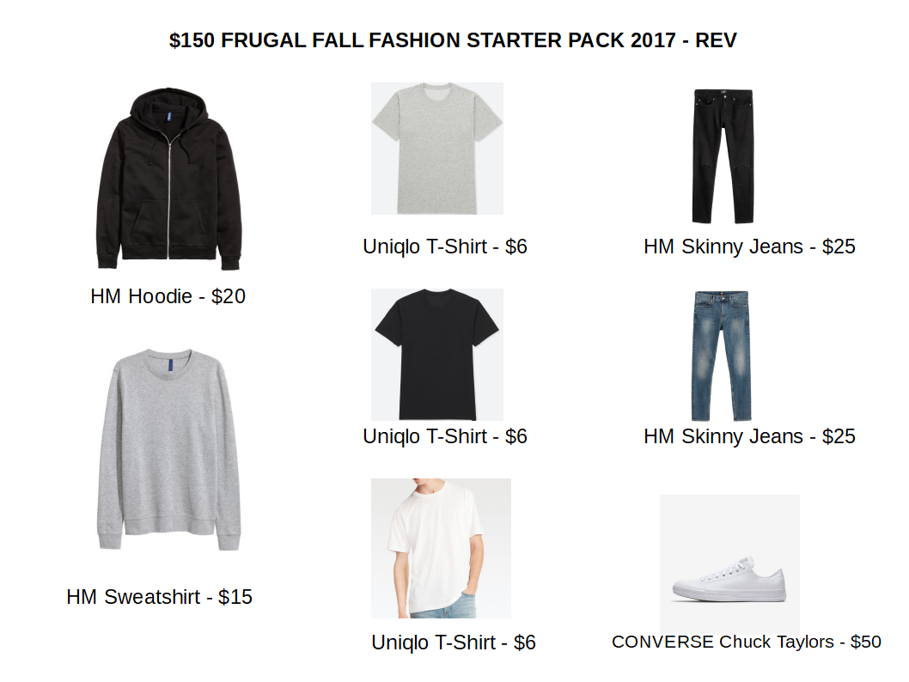
Inspiration

Slide 4
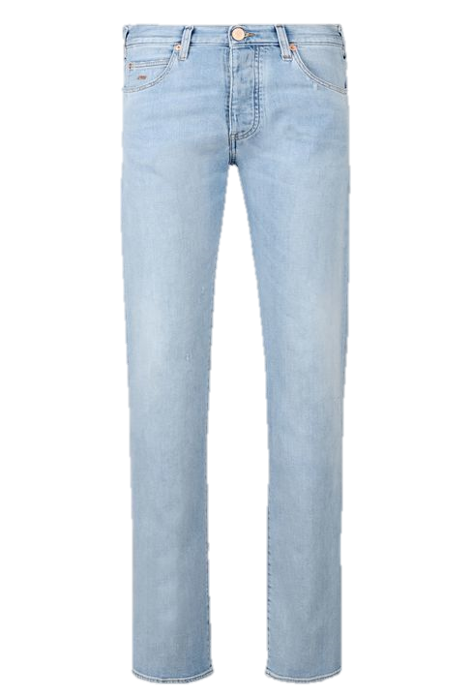
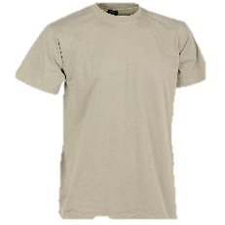
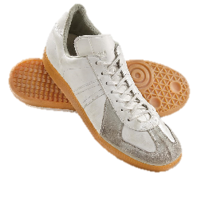
Demo.
Lightwash Denim: Versatile especially during the cooler months. Works best in Palewave outfits. Stick to these or black jeans.
Beige T-Shirt : Earth tones can be easily be a nice addition to your wardrobe. They’re incredibly versatile, understated pieces that accentuate your any outfit.
German Army Trainers: versatile and available in a variety of qualities from a variety of places. Looks great on most, if not all, Palewave outfits.

Slide 5
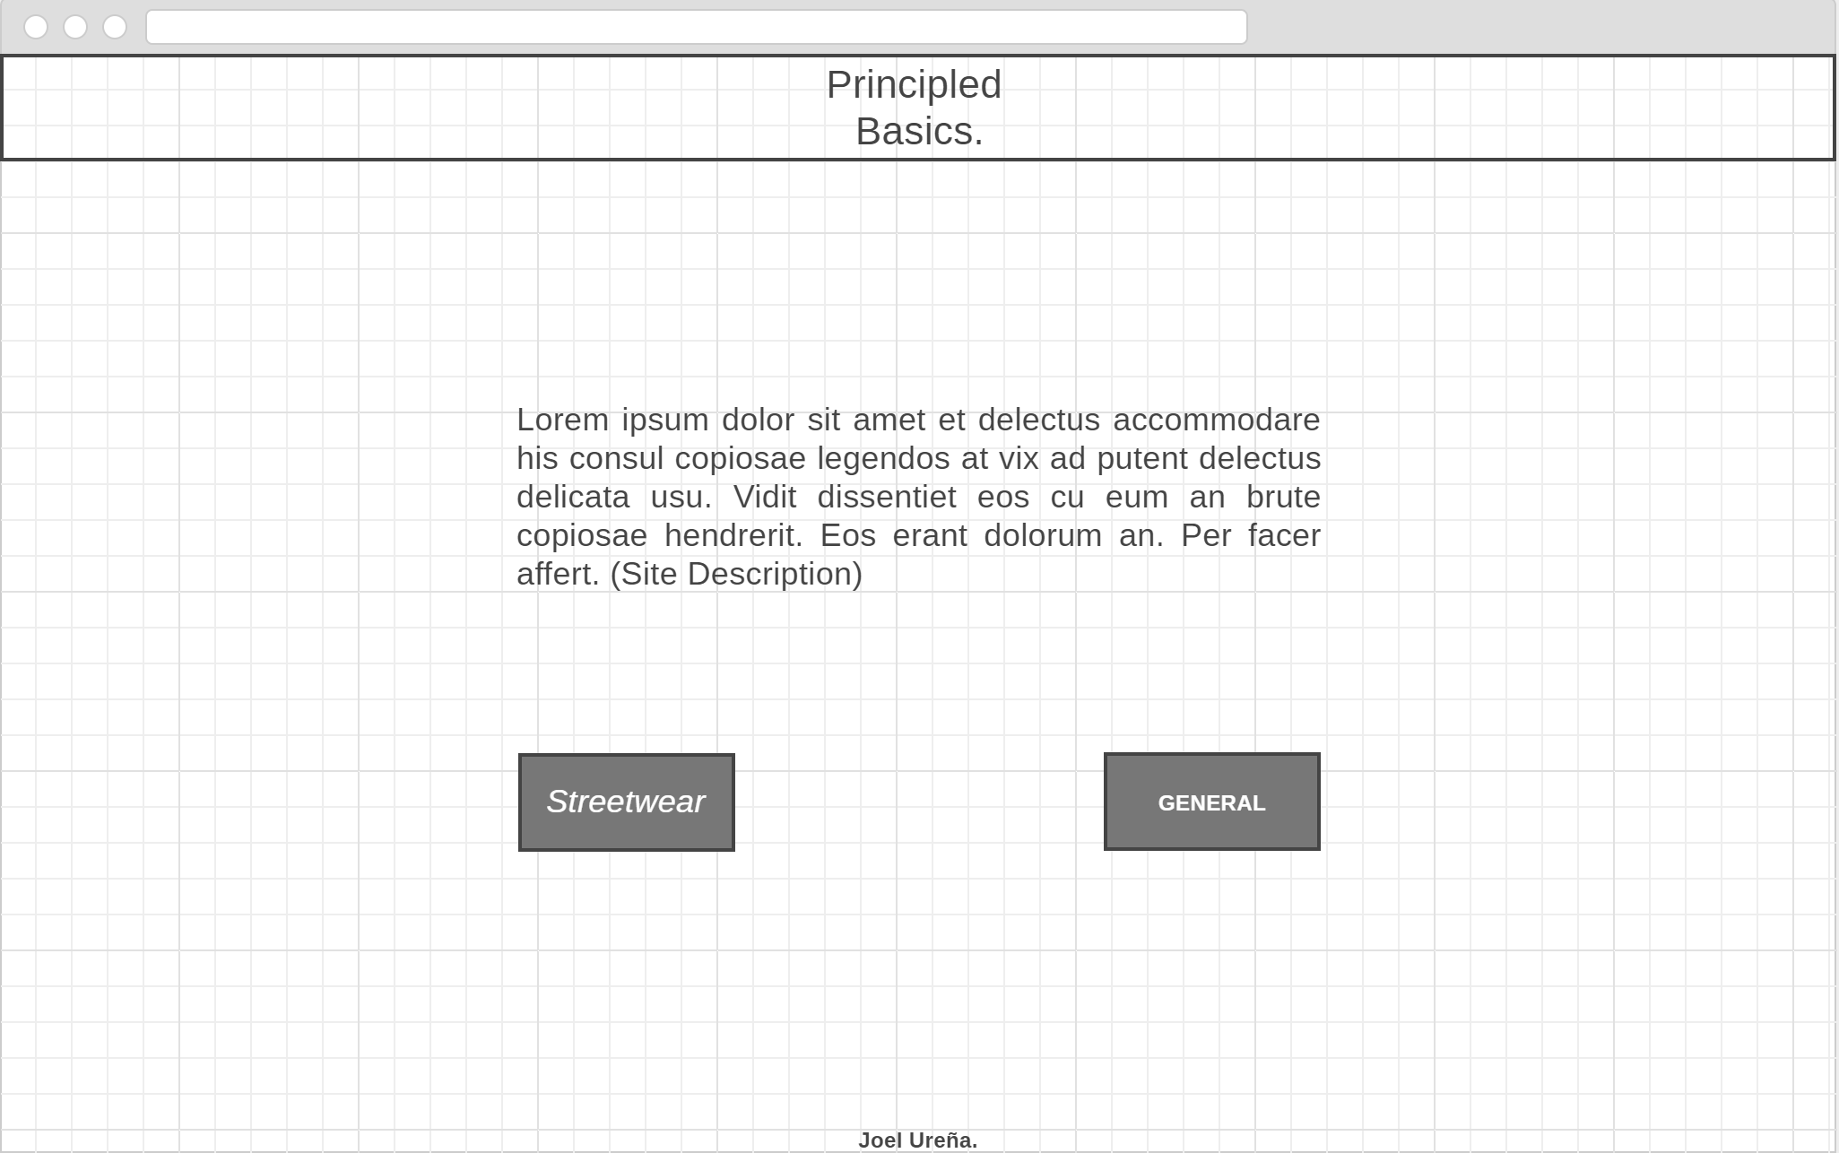
Wireframes.

Slide 6
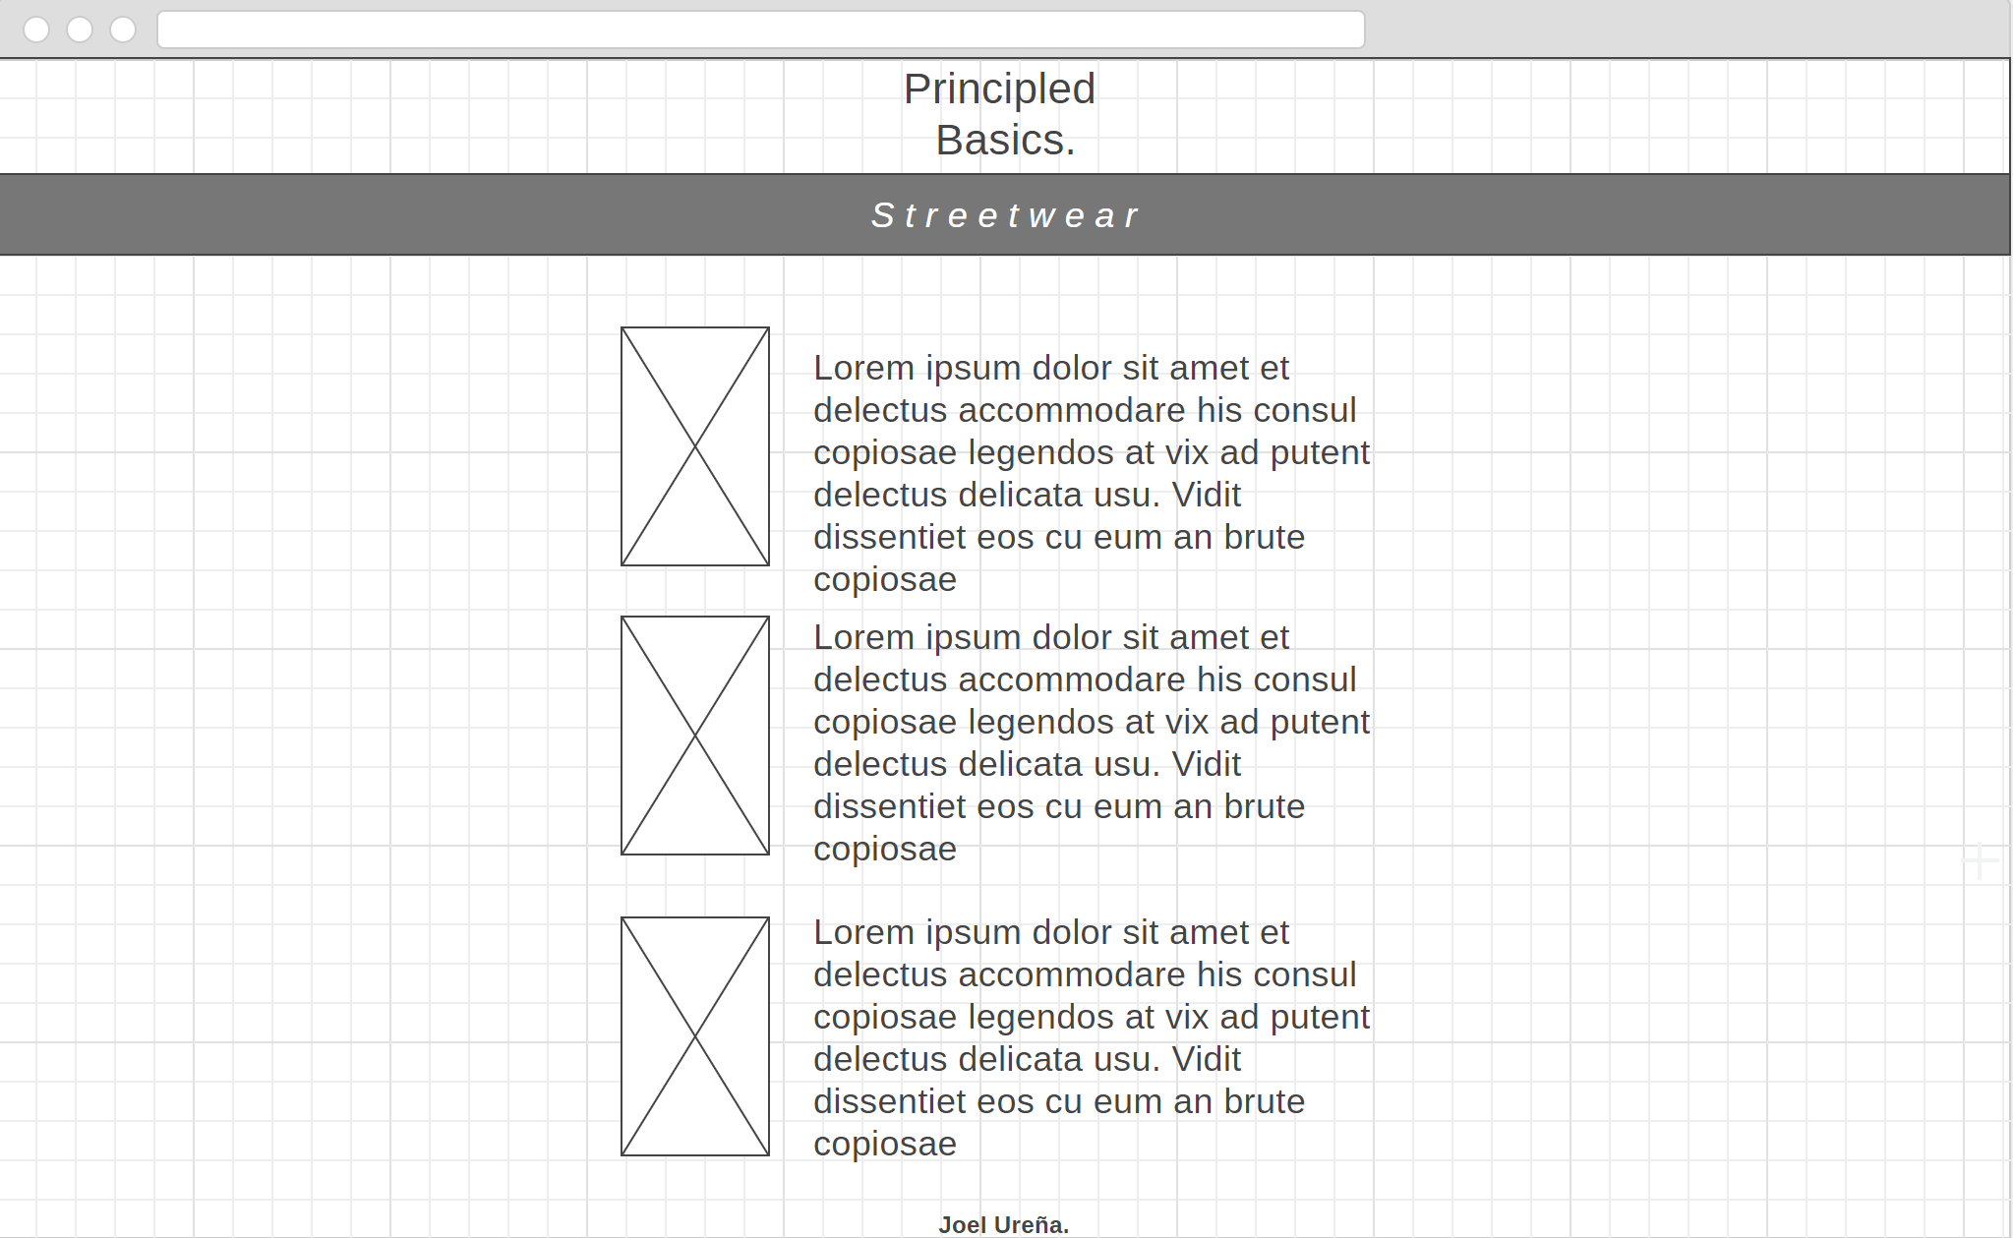
Wireframes.

Slide 7
Site map
Home Page
Streetwear
General
Joel Urena
Bottoms
Bottoms
Bottoms
Tops
Tops
Tops
Footwear
Footwear
Footwear

Slide 8
How it’s made.
CSS
Transformations to make the text pop up based on clicking the image
Box Model for Title, Header, Footer and button
Div classes and IDs for the elements above

Slide 9
Questions?

